Slide 1

CS 577: Deep Learning Project Presentation
SUBMITTED BY:
PARTH GUPTA (A20449774)
SHIRISH VOGGA (A20456808)

Slide 2
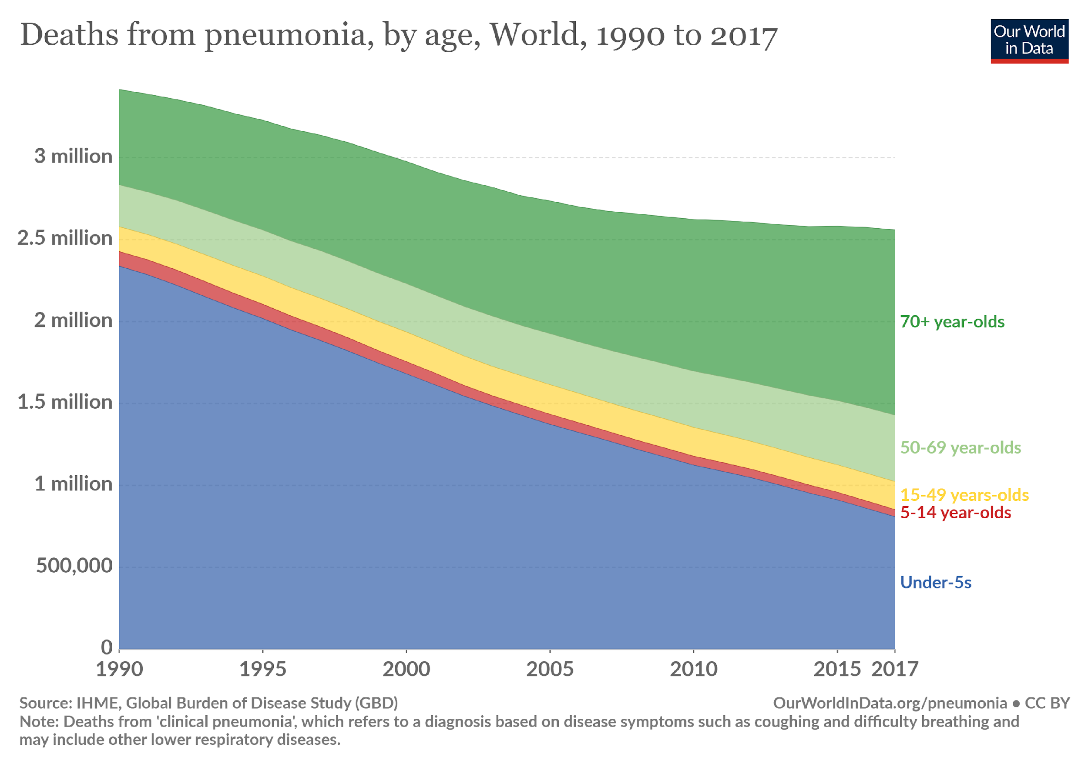
Problem Statement
Predict if a given X-ray image has Pneumonia or not.
Why is it important...?

Slide 3
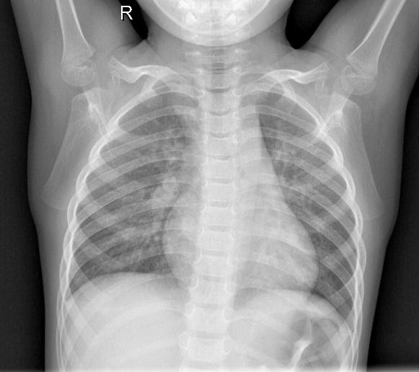
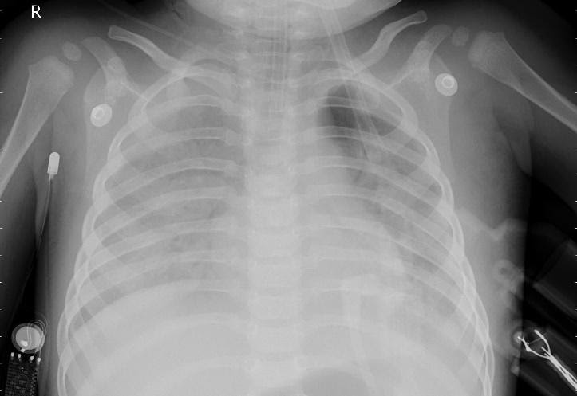
Problem Statement
Requirement of computer-aided analysis for prediction.
Normal Case Pneumonia Case

Slide 4
Problem Statement
We use CNN to build our custom model.
We then, use transfer learning to build models on VGG16 and Xception.
We train on the train set and validate on the validation set.
Final metric of evaluation is precision and f1-score, validated on the test set.
We refer and build our models based on the papers published in IEEE and Arxiv.
Dataset:
We download the data from Kaggle. This data was imbalanced and we created two datasets (Balanced and default imbalanced).
5862 images are found in the imbalanced dataset.

Slide 5
Proposed Solution
We use keras GPU framework to import VGG16 and Xception models.
Next, we create train, validation and test directories, each with two sub-directories of normal and pneumonia images.
Data augmentation steps like image zoom, contrast change, whitening and blurring were done to avoid overfitting.
Lastly, we create a custom model and perform hyper tuning as necessary.
Going forward, we implement models on VGG16, both with frozen and unfrozen layers. Perform hyper-tuning and augmentation as necessary.
Further model was trained on Xception as well to compare the final results of each model.

Slide 6
Implementation
For training the vgg16 model we first freeze all the weights and then load the training images in the resolution of 224*224 as mentioned in paper. Later we unlock the top 8 layers as mentioned in the paper and retrain our model.
Next, for the Xception model which is designed to accept images of 299*299 resolution, we load the images at that resolution and train the same way we trained VGG16.
However here we unlock just top 2 layers of the network since xception is a large network and unlocking more layers leads to degraded performance due to overfitting.
In order to avoid overfitting we introduce batch normalization and dropout layers of 0,5 after each convolution block.
We use adam optimizer and set the learning rate small to 1e-5 since its a large network and we do not want large gradient updates to be pushed to the network.
Finally we train the model for 40 epochs , with a batch size of 20

Slide 7
Implementation
Like VGG16 and Xception we also write our own convolutional neural network with 5 convolution layers of filter 3*3 and each layer is followed by a maxpooling layer.
Later we flatten the output of the convolutional block so that we can then feed to a dense layer for classification
Similarly in order to avoid overfitting we add dropout layers and l2 regularizer for each layer in the network so that the model does not overfit and moreover we also argument the images so it does not overfit and can also make a better prediction
Lastly we measure the precision and recall for each class as our end results.

Slide 8
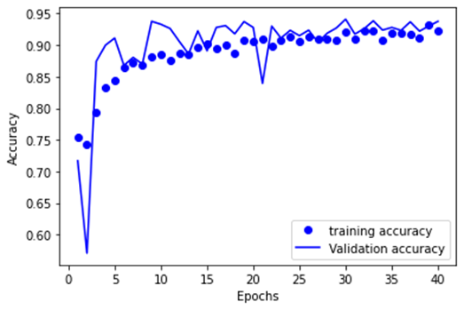
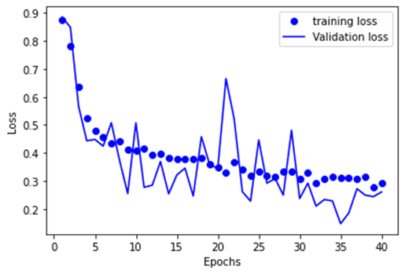
Results
Custom CNN model

Slide 9
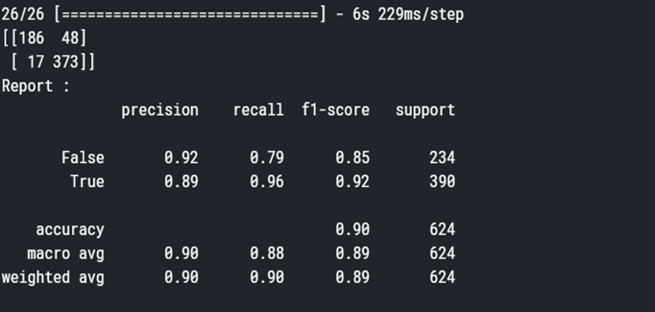
Result
Summary for Custom CNN model

Slide 10
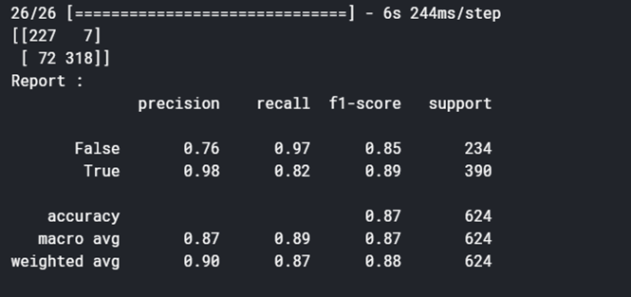
Results
Summary for VGG16

Slide 11
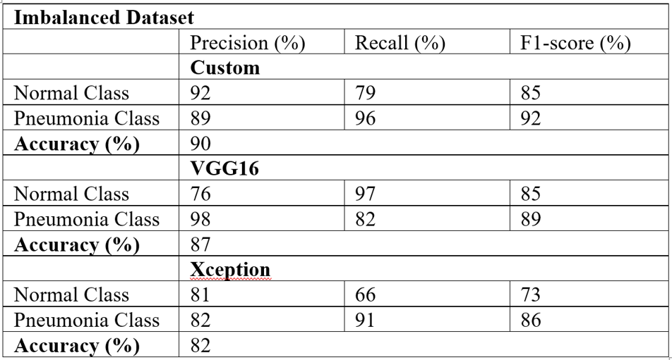
Results

Slide 12
References
IHME, Global Burden of disease study (GBD)
https://ourworldindata.org/pneumonia#burden-of-pneumonia
Mooney, Paul. “Chest X-Ray Images (Pneumonia).” Kaggle, March 24, 2018.
https://www.kaggle.com/paultimothymooney/chest-xray-pneumonia/metadata
E. Ayan and H. M. Ünver, "Diagnosis of Pneumonia from Chest X-Ray Images Using Deep Learning," 2019 Scientific Meeting on Electrical-Electronics & Biomedical Engineering and Computer Science (EBBT), Istanbul, Turkey, 2019, pp. 1-5.
https://ieeexplore.ieee.org/document/8741582
J. Ker, L. Wang, J. Rao and T. Lim, "Deep Learning Applications in Medical Image Analysis," in IEEE Access, vol. 6, pp. 9375-9389, 2018.
https://ieeexplore.ieee.org/abstract/document/8241753

